Slide 1
BUILDING
BETTER
FIGURES

Slide 2

WHAT FIGURES DO
COMMUNICATE IDEAS
UNITE CONCEPTS
ENTERTAIN

Slide 3

GOOD FIGURES
TELL THE WHOLE STORY
EASILY INTERPRETABLE
PLEASE THE EYES

Slide 4
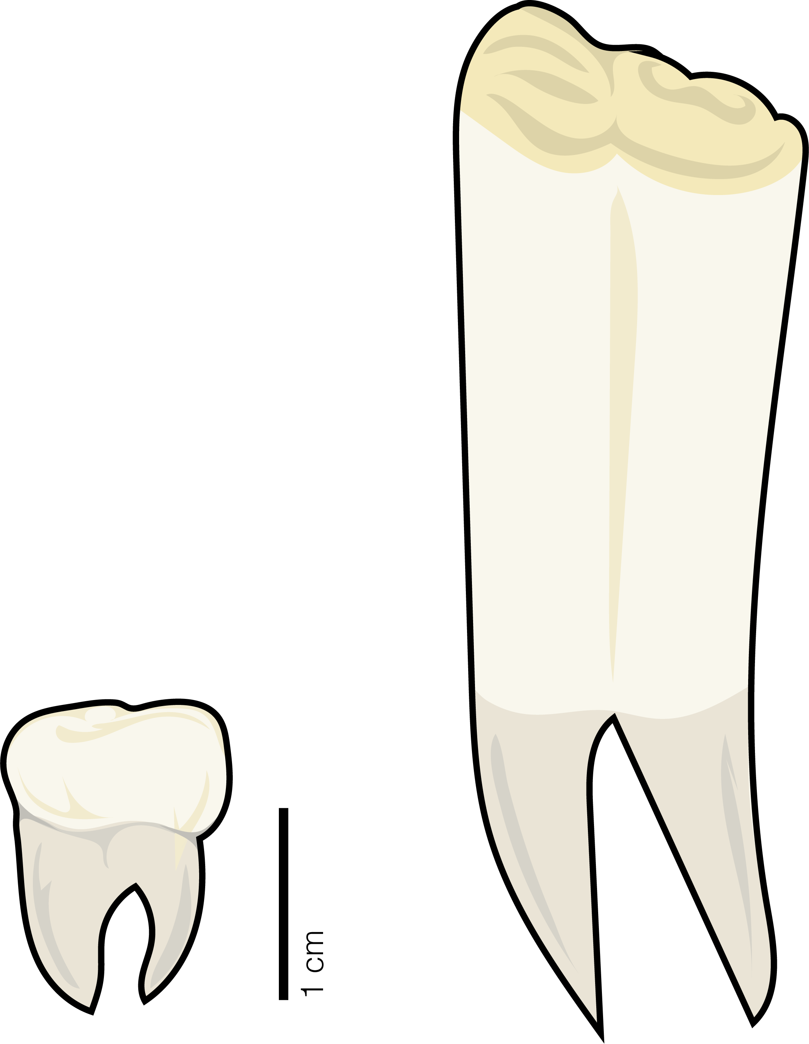


PAPER
FIGURES
TALK
FIGURES
# SPECIES
POSTER
FIGURES
HABITAT TYPE

Slide 5
PAPER
FIGURES
MUST
STAND ON
THEIR OWN
# SPECIES
HABITAT TYPE

Slide 6
MOSTLY
STAND ON
THEIR OWN
POSTER
FIGURES

Slide 7
TALK
FIGURES
CAN
RELY ON
YOUR TALK

Slide 8
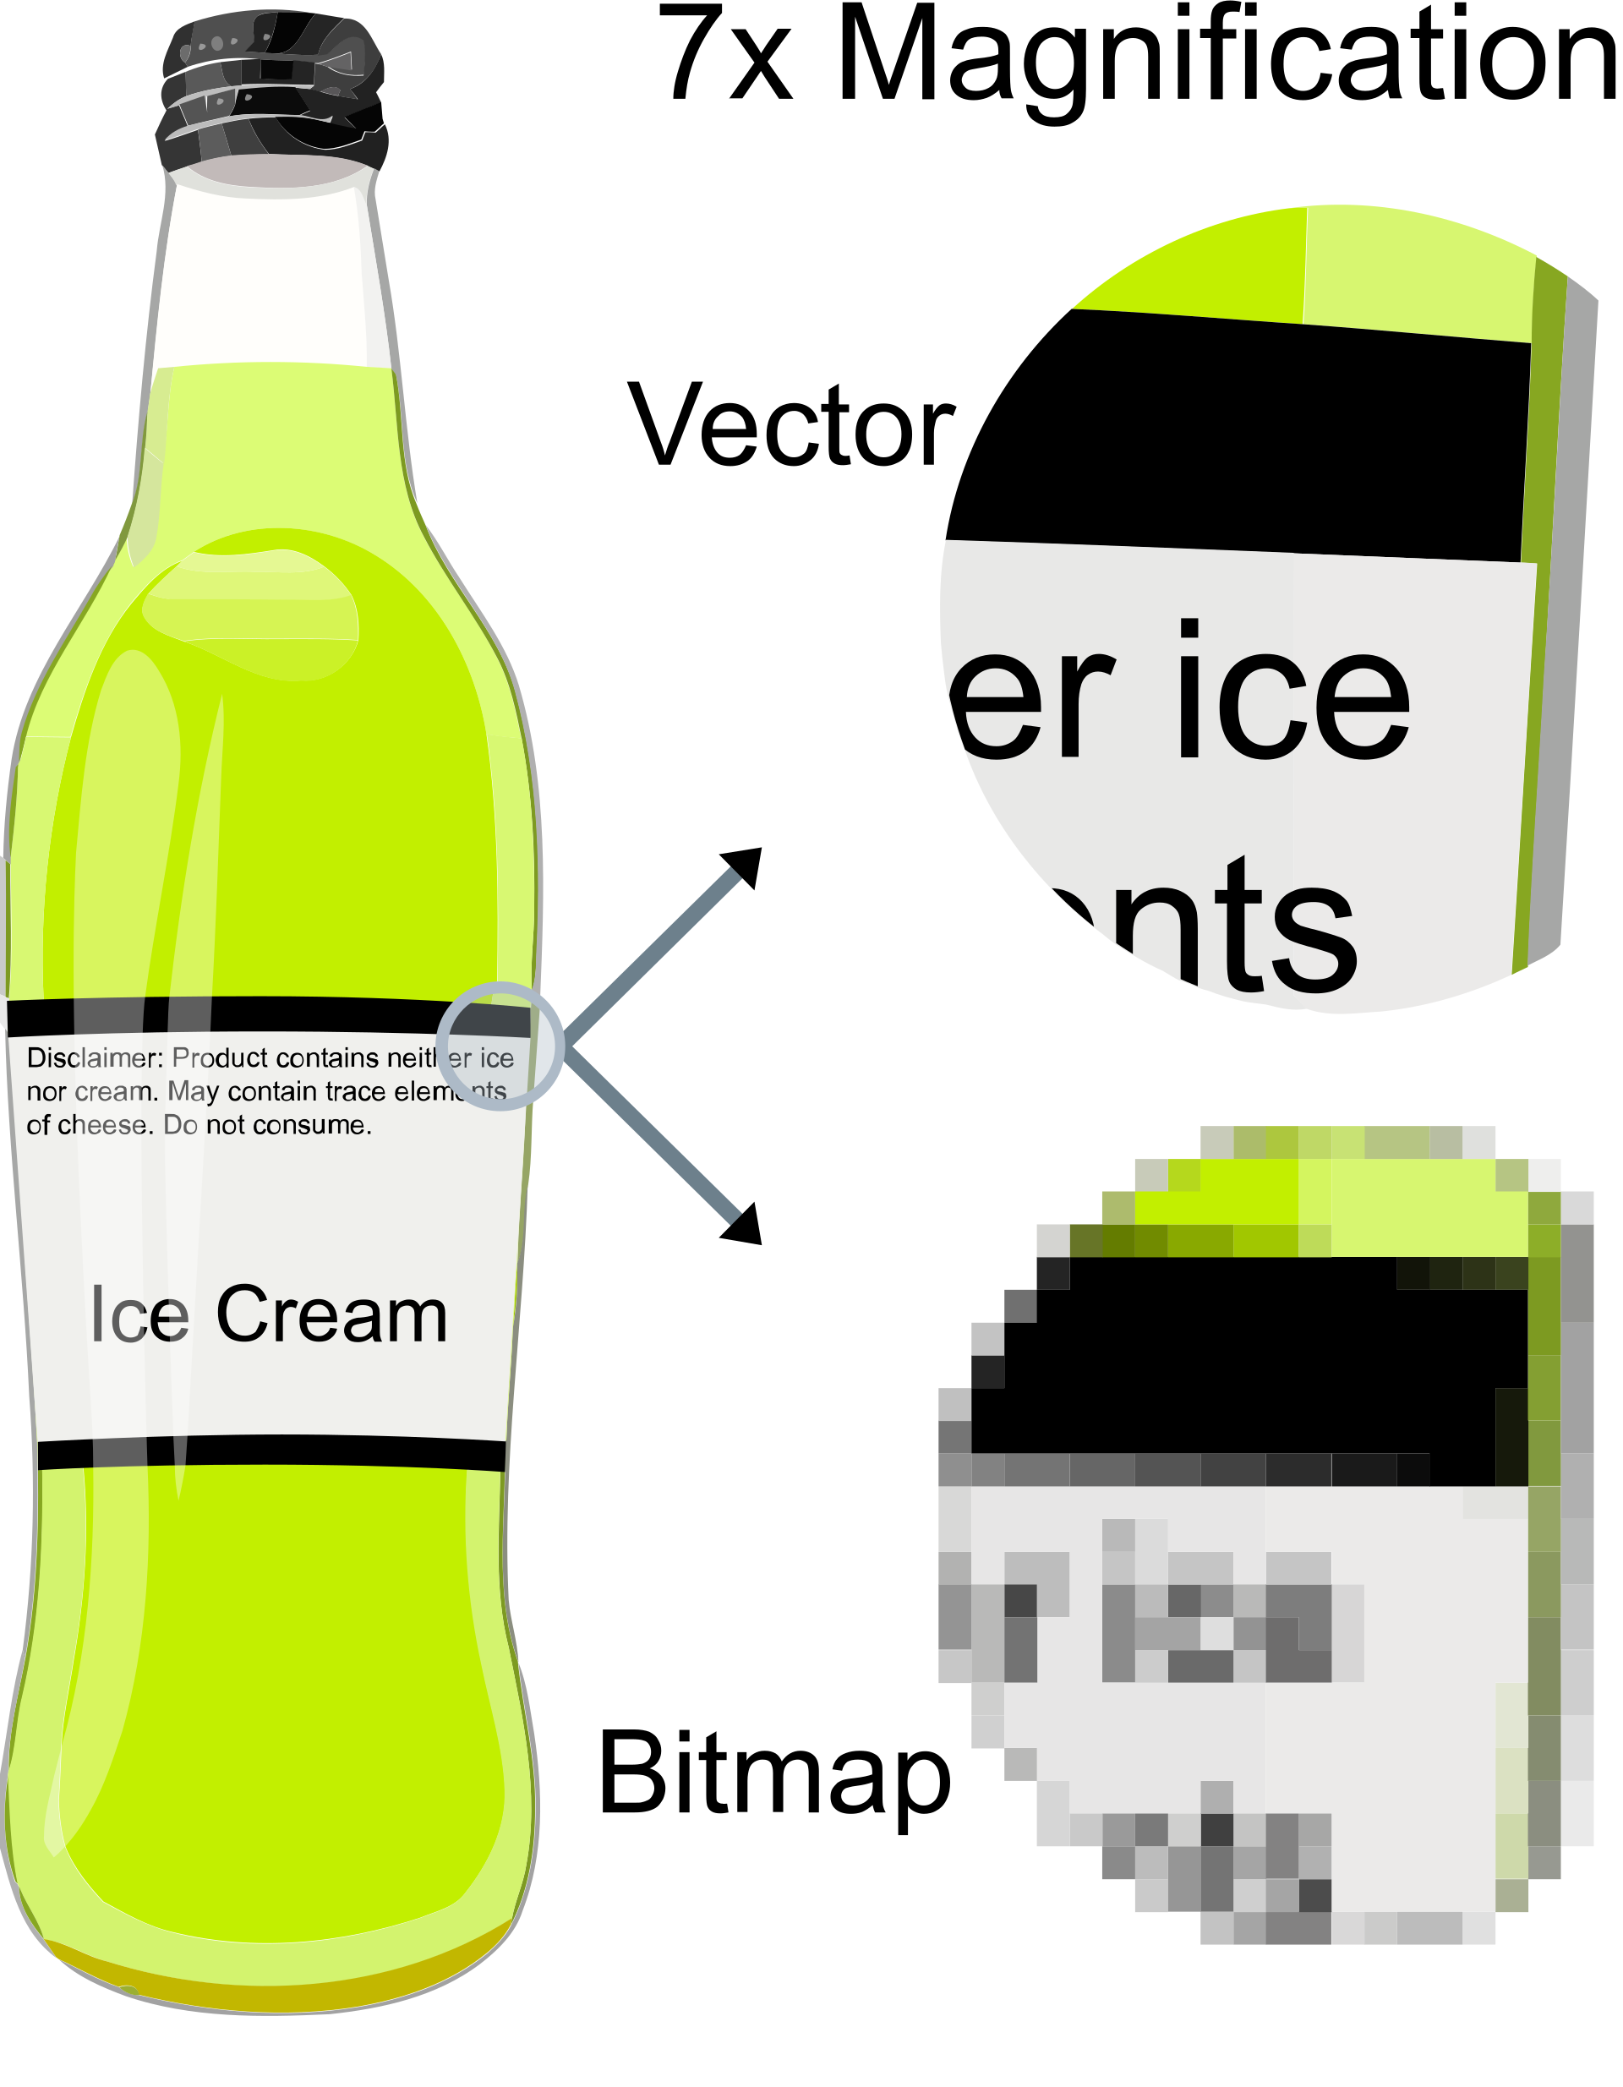
FILE TYPES
RASTER
PNG
JPEG
GIF
VECTOR
SVG
PDF
EPS

Slide 9
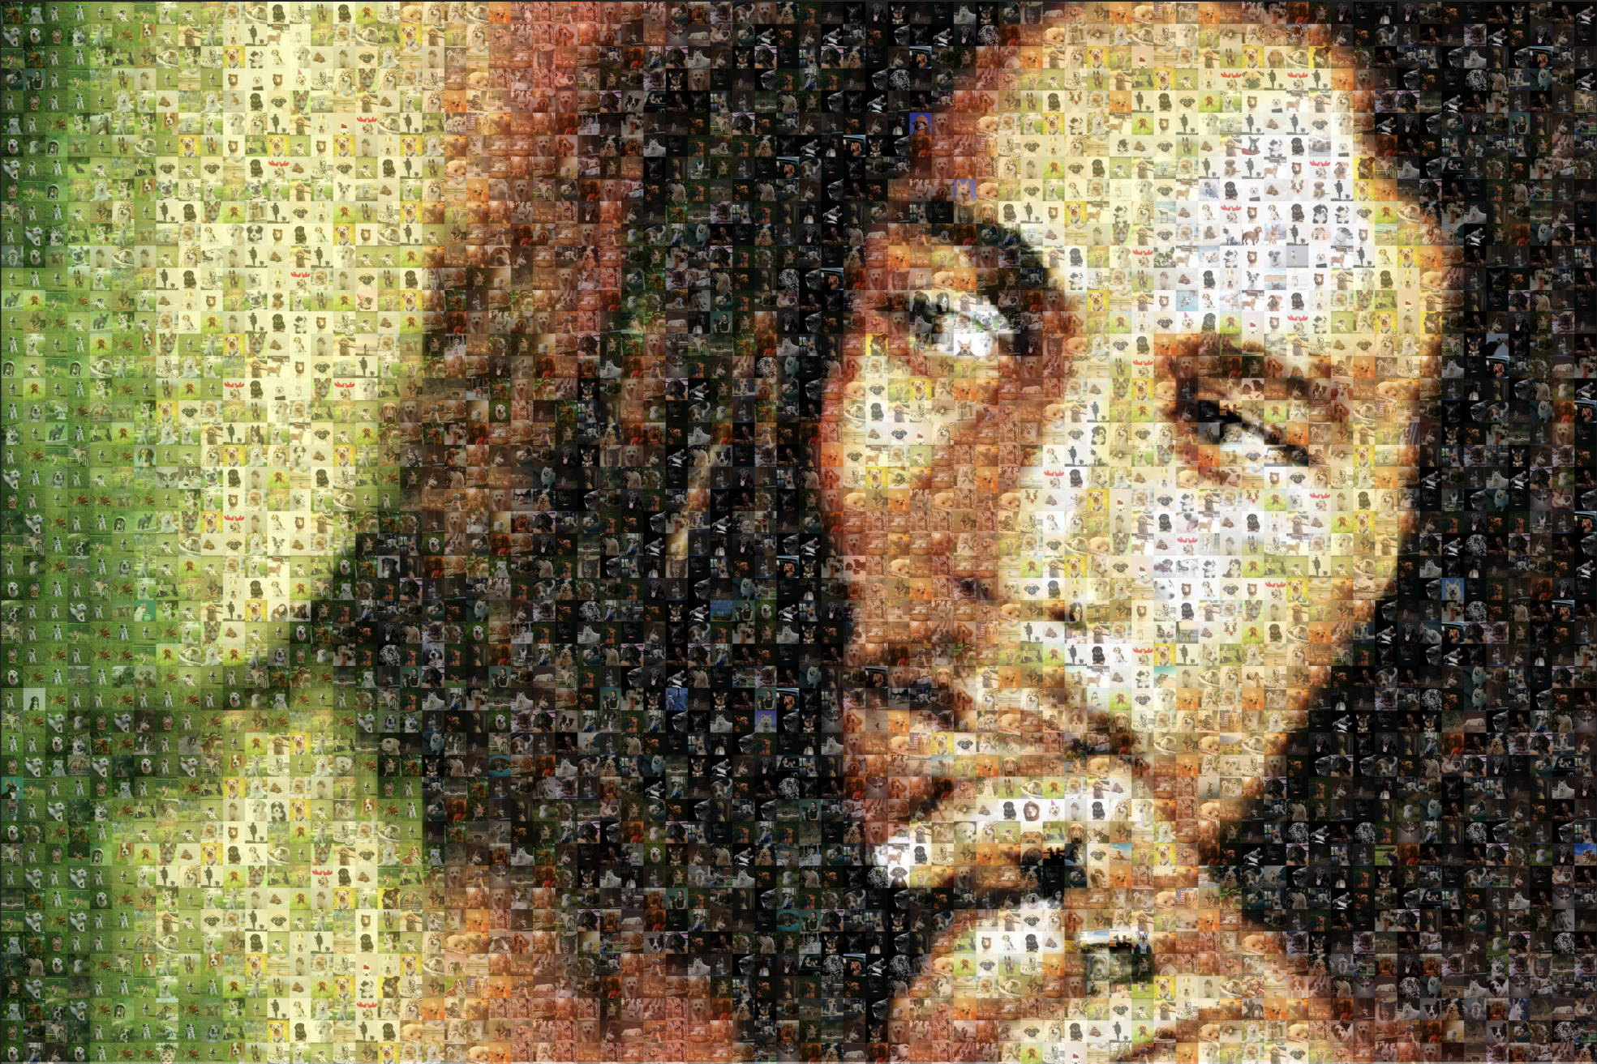
RASTA RASTER

Slide 10
AESTHETIC PRINCIPLES
SHAPE
•
SPACE
•
COLOR
BALANCE
•
MOVEMENT
•
PROPORTIONS

Slide 11
AESTHETIC PRINCIPLES
SHAPE
•
SPACE
•
COLOR
BALANCE
•
MOVEMENT
•
PROPORTIONS

Slide 12
S H A P E
CAN I USE SHAPE TO CONVEY AN IDEA?
•
WHAT SHAPE SUITS MY PRESENTATION?
•
CAN SHAPE CONTRIBUTE TO FLOW?

Slide 13
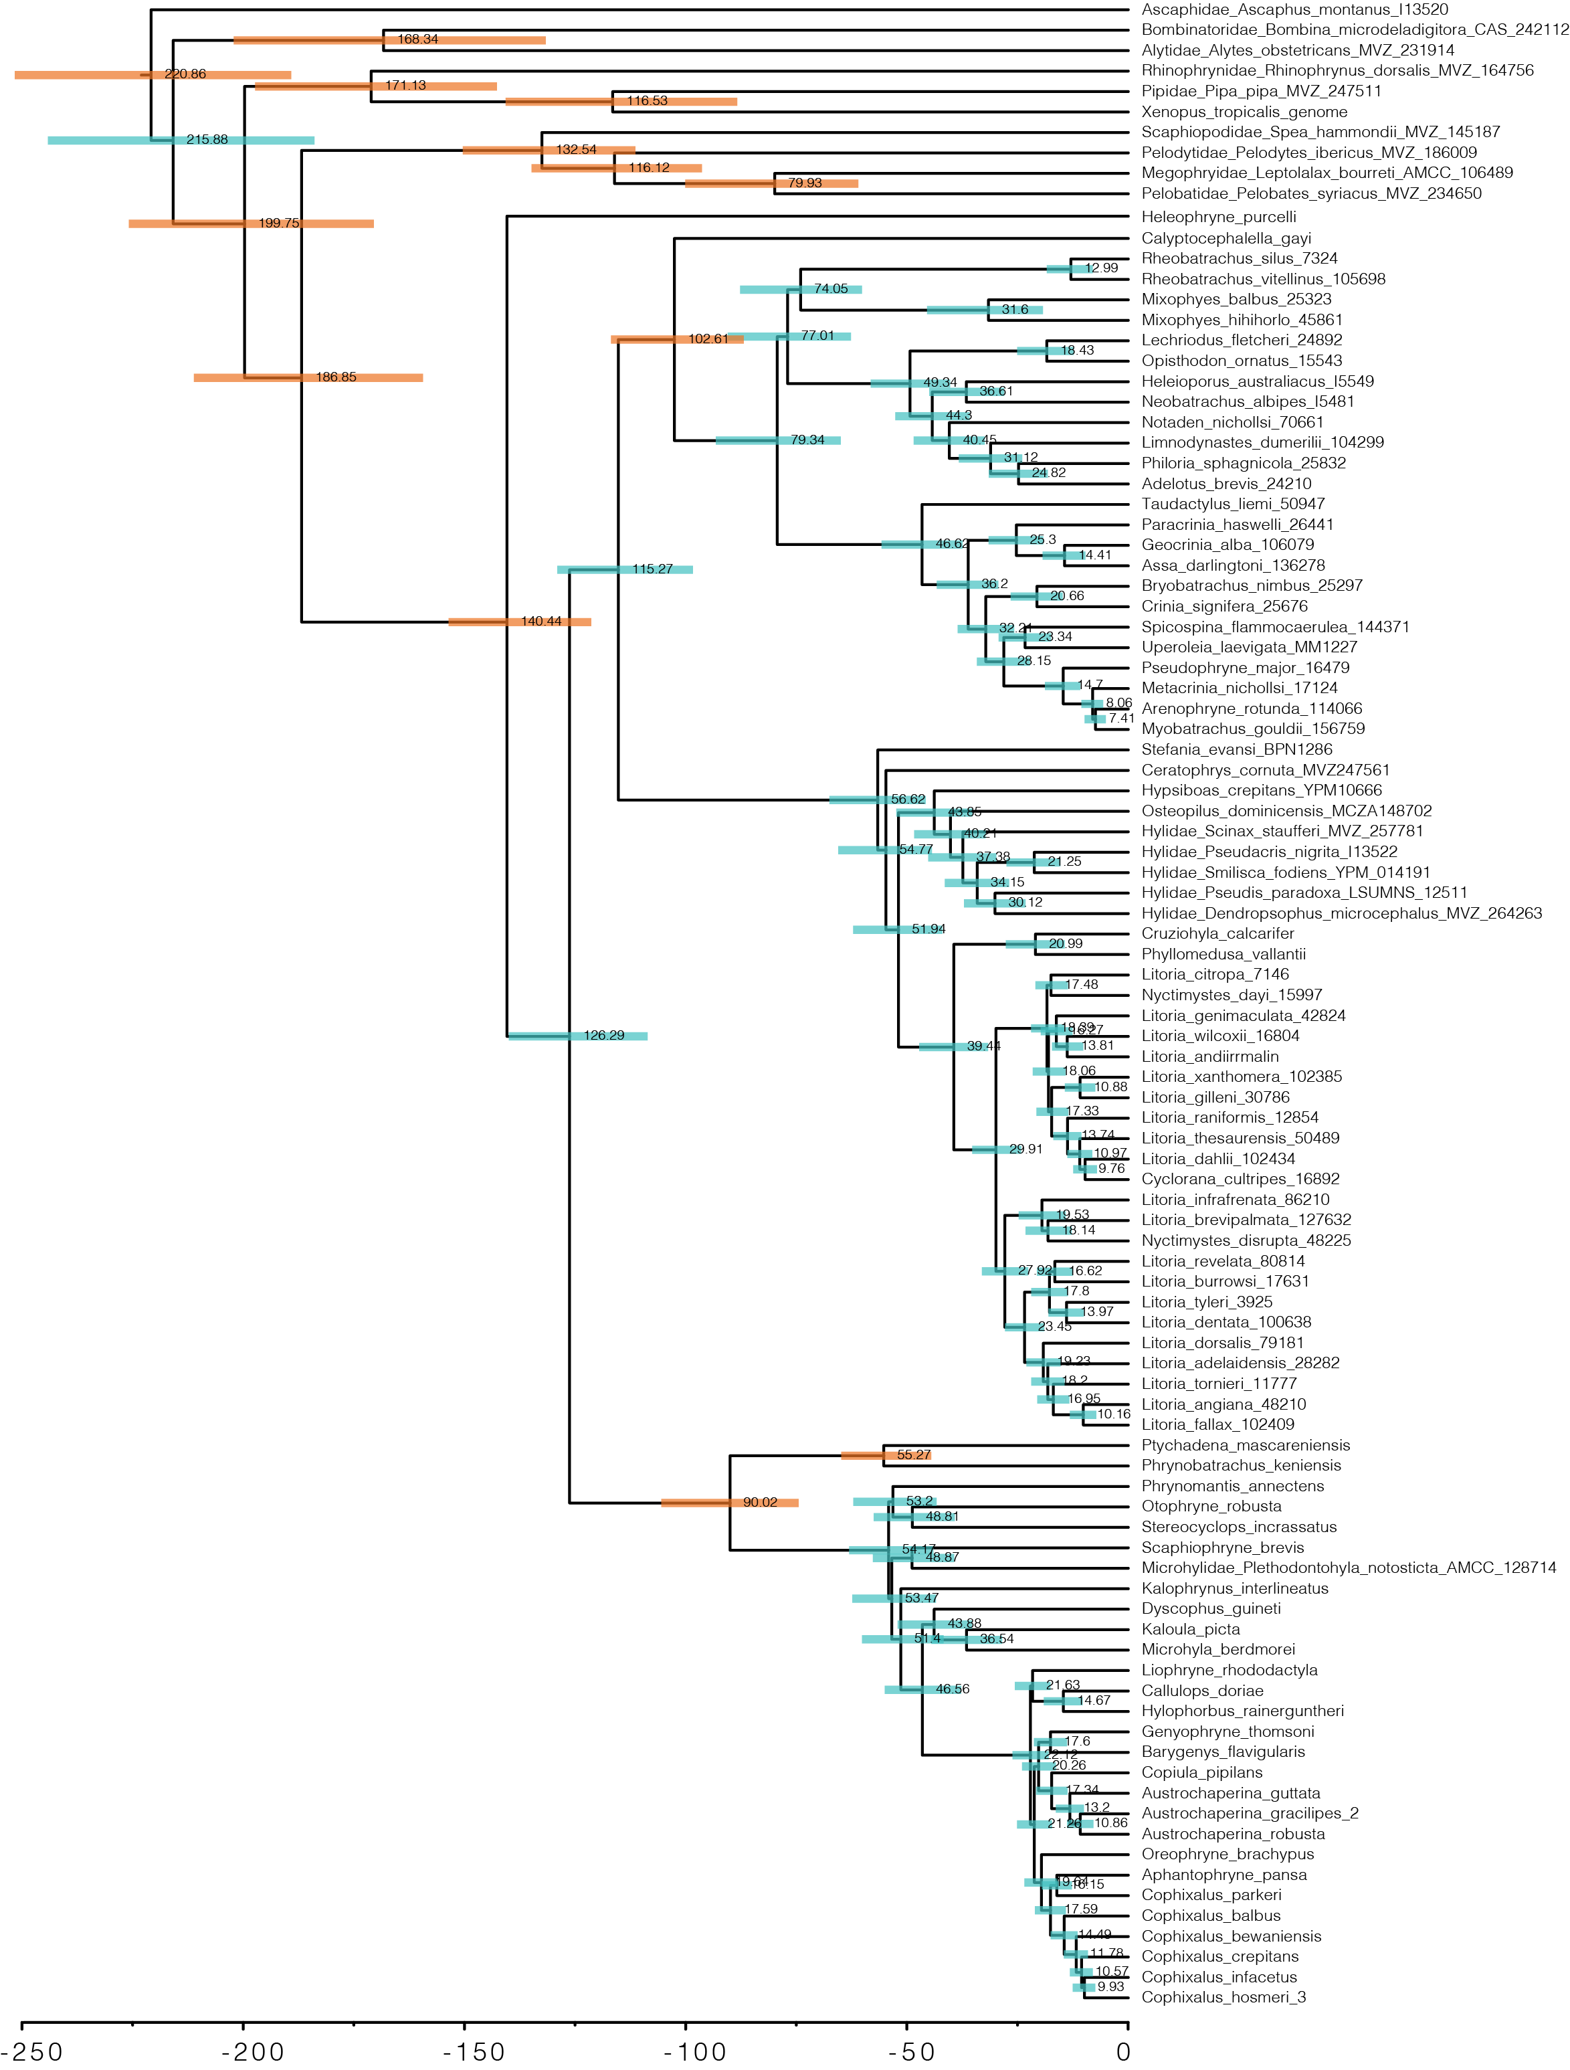
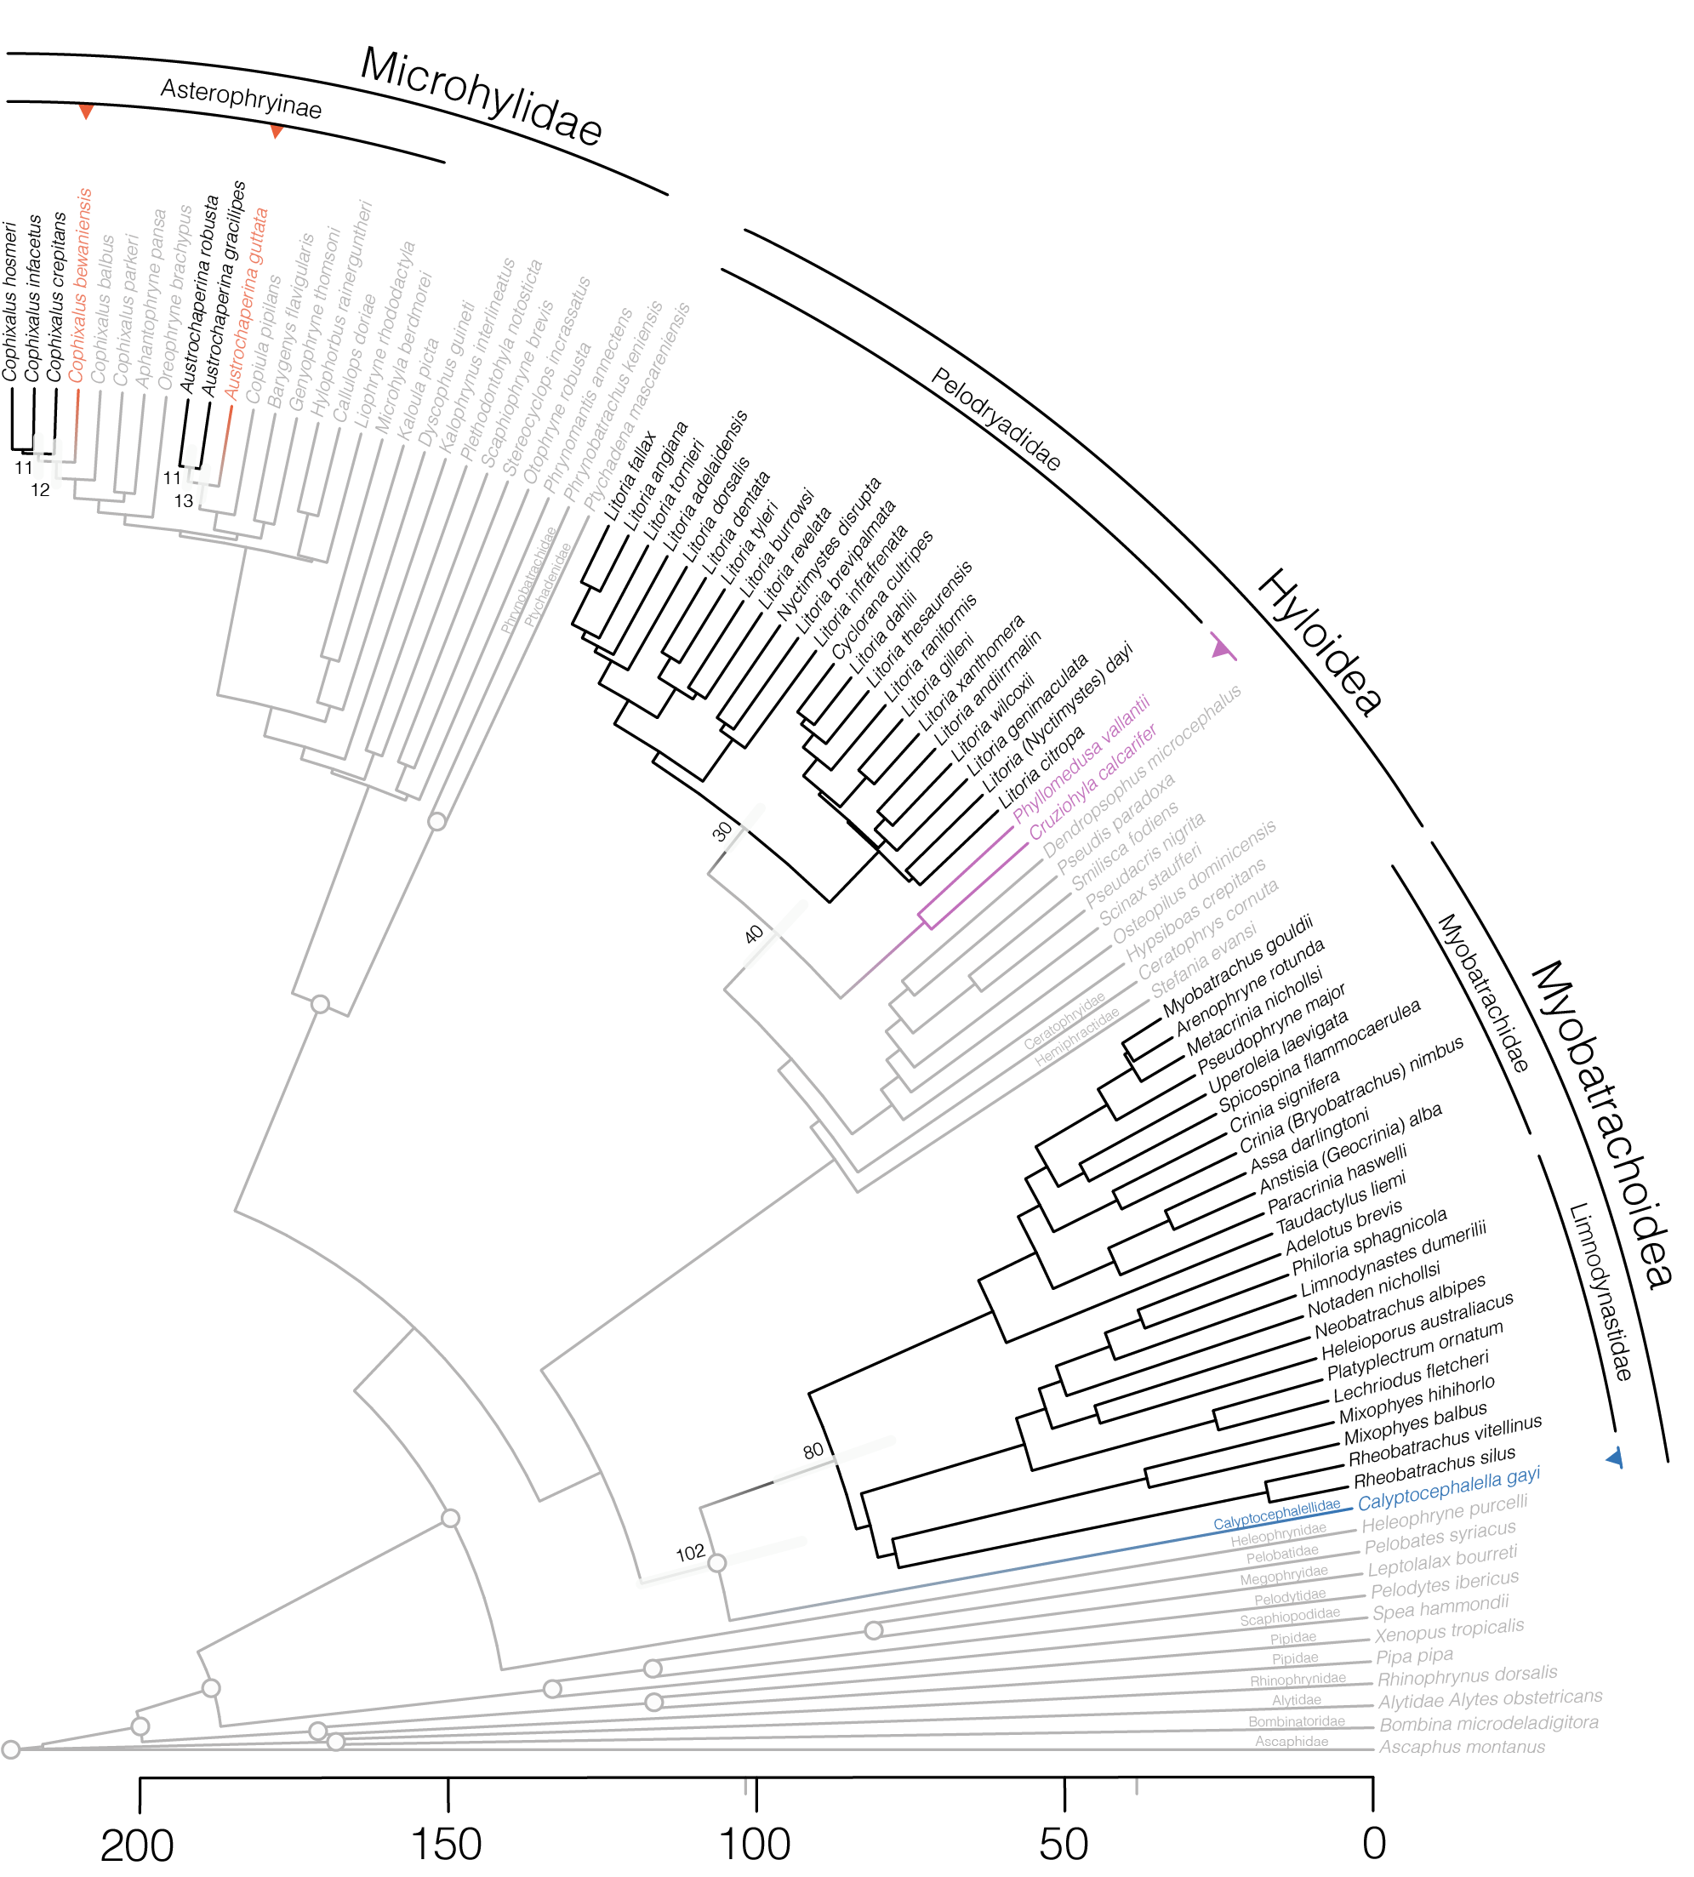

Slide 14
S P C E A
DO ELEMENTS HAVE ROOM?
•
IS MY FIGURE CRAMPED?
•
ARE DIFFERENT IDEAS DELIMITED?
•
IS THERE TOO MUCH SPACE?

Slide 15
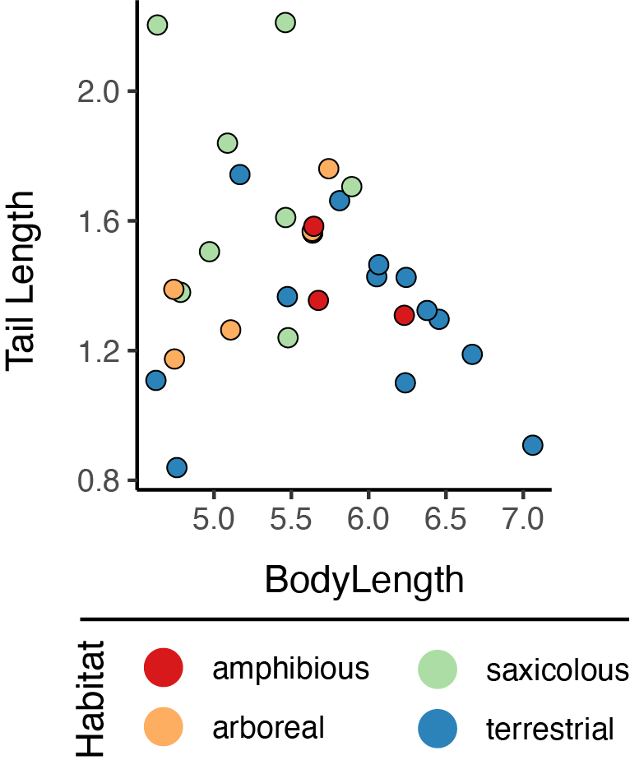
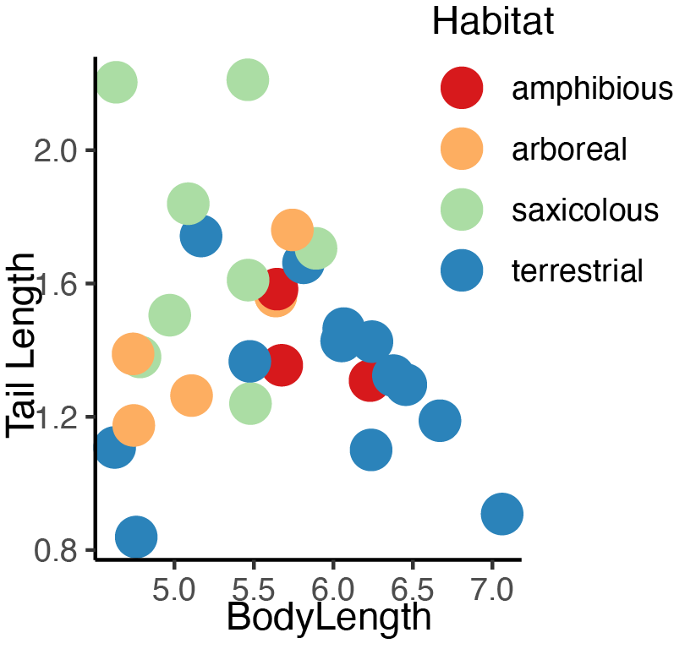

Slide 16
C O L O R
HUE
•
SATURATION
•
SHADE
•
OPACITY/TRANSPARENCY

Slide 17
C O L O R
COLOR FOR EMPHASIS
•
COLOR TO DISTINGUISH
•
COLOR FOR AESTHETICS

Slide 18
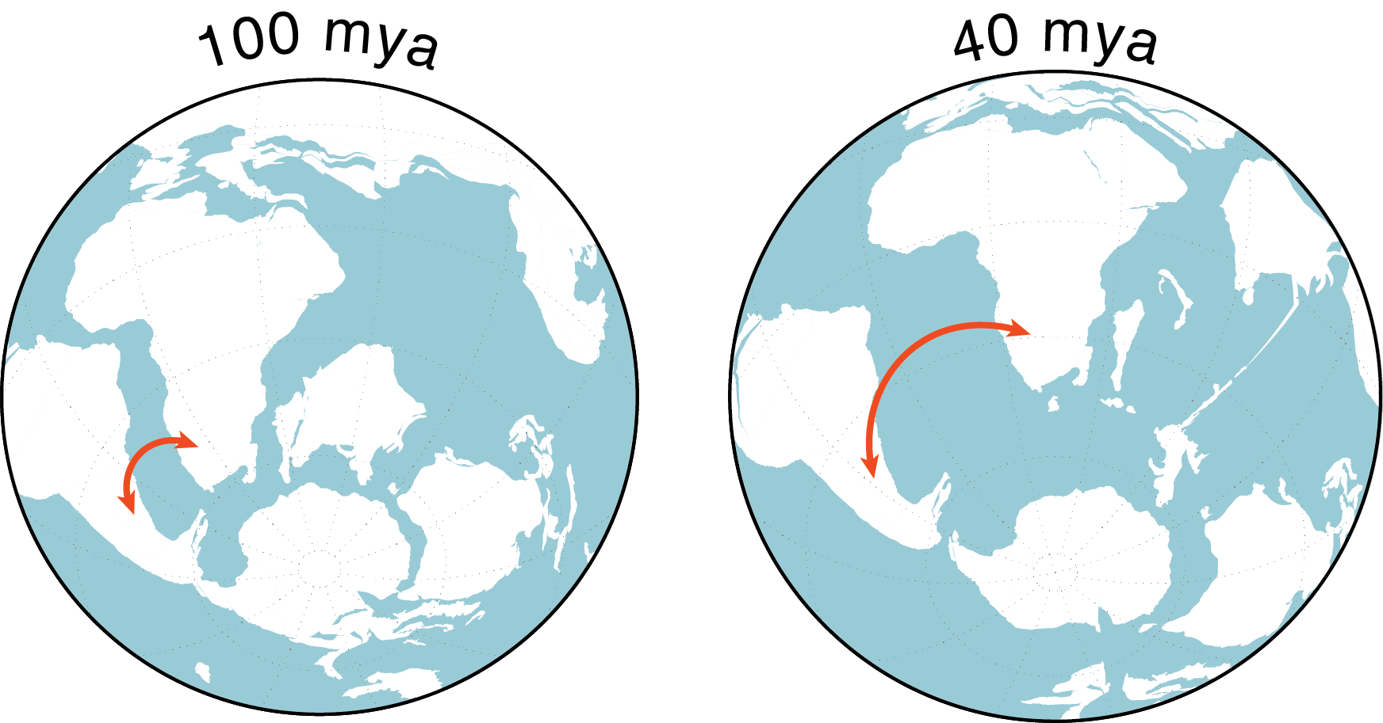
E X A M P L E
DISPERSAL LIKELIHOODS
DISPERSAL DECREASES AS A FUNCTION OF DISTANCE

Slide 20
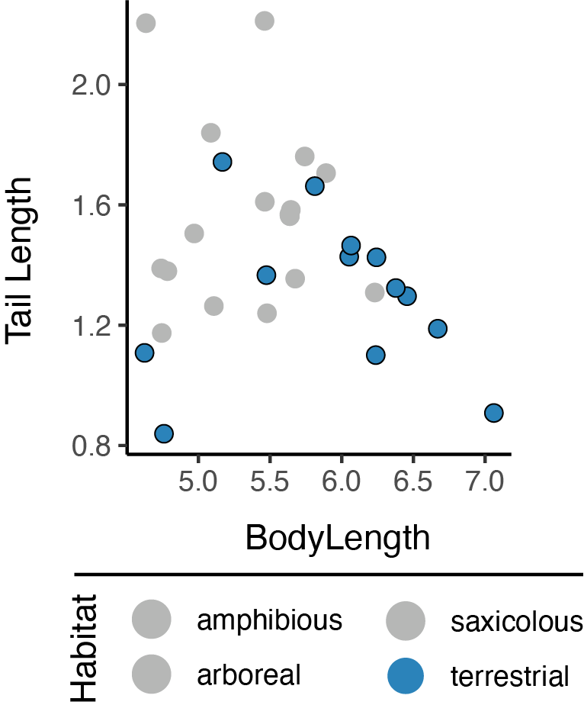

Slide 21
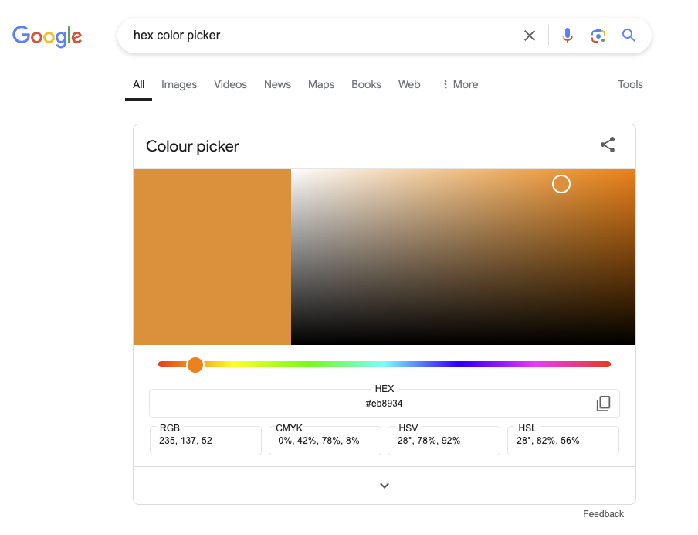
HEX COLOR PICKER

Slide 22
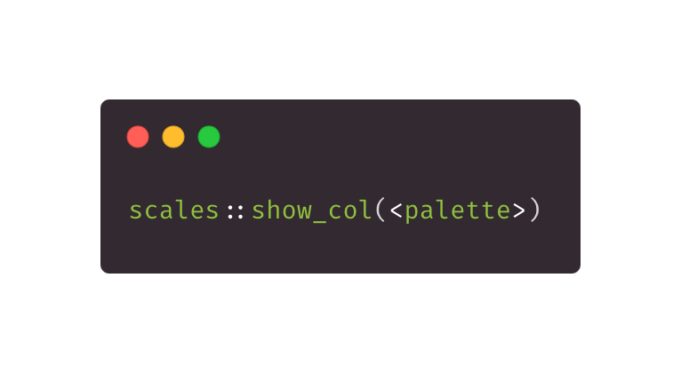
BRING YOUR #HEX

Slide 23
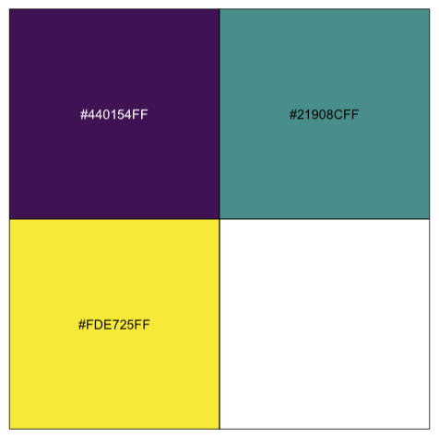

BRING YOUR #HEX

Slide 24
← MOVEMENT →
IS THERE A NARRATIVE?
•
AM I LEADING THE VIEWER?
•
SINGLE OR MULTIPART FIGURE?

Slide 25






E X A M P L E
80_{MY}
0_{MY}

Slide 26


E X A M P L E
40_{MY}
0_{MY}

Slide 27



E X A M P L E
0_{MY}
30_{MY}

Slide 28
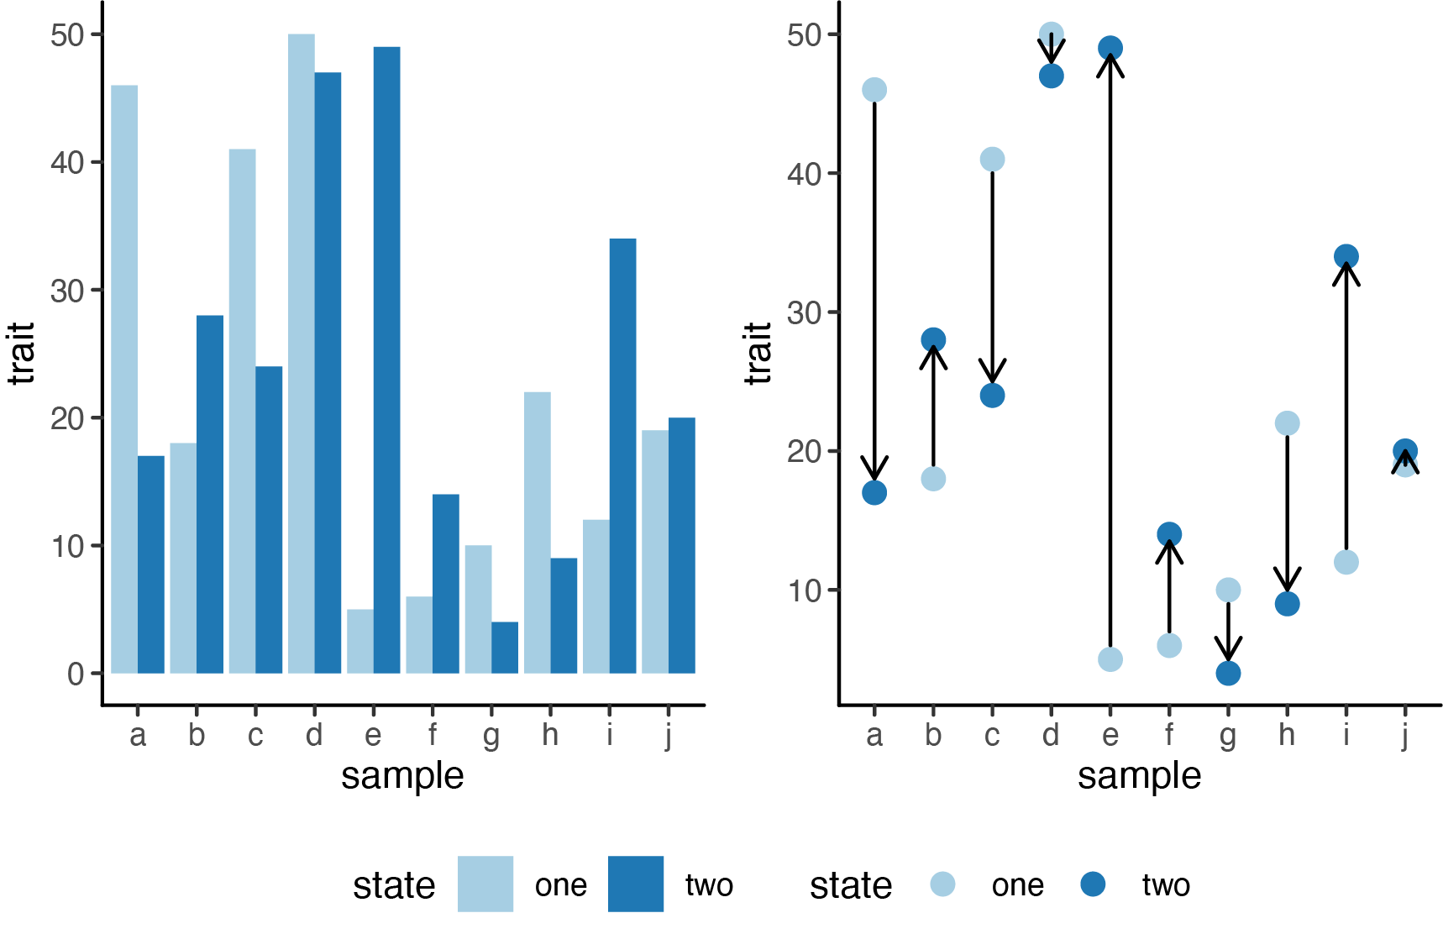

Slide 30
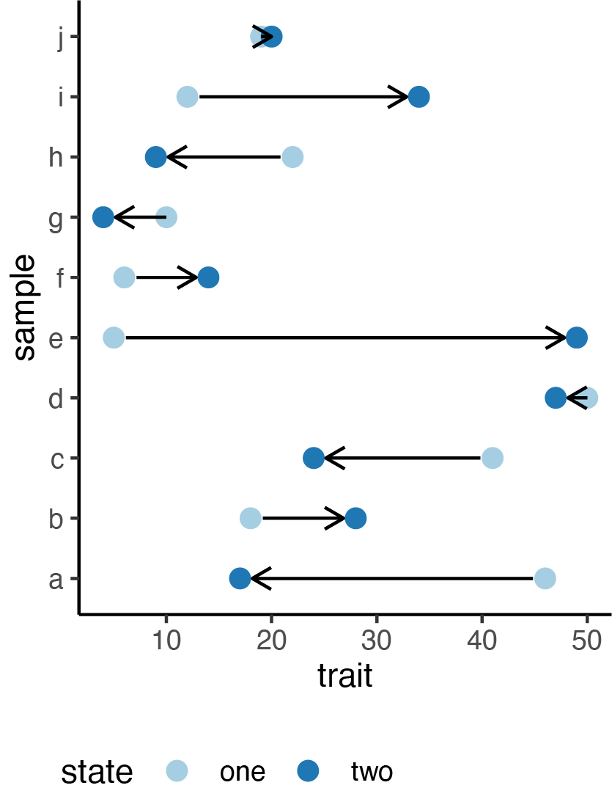

Slide 31
PROPORTIONS
DO PROPORTIONS MATTER? (PCA)
•
CAN I CONVEY IMPORTANCE?
•
SOME PORPORTIONS DON’T WORK

Slide 32
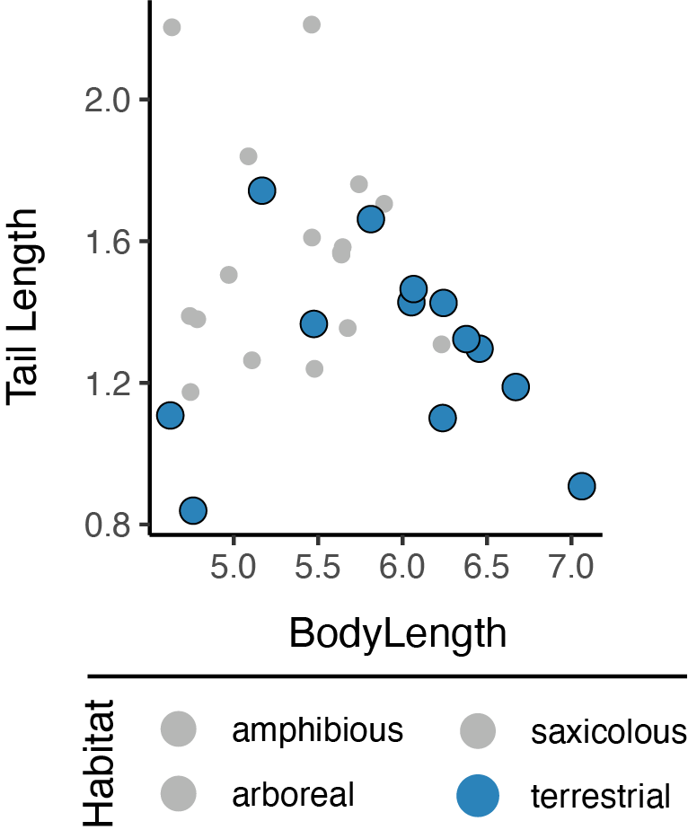

Slide 33
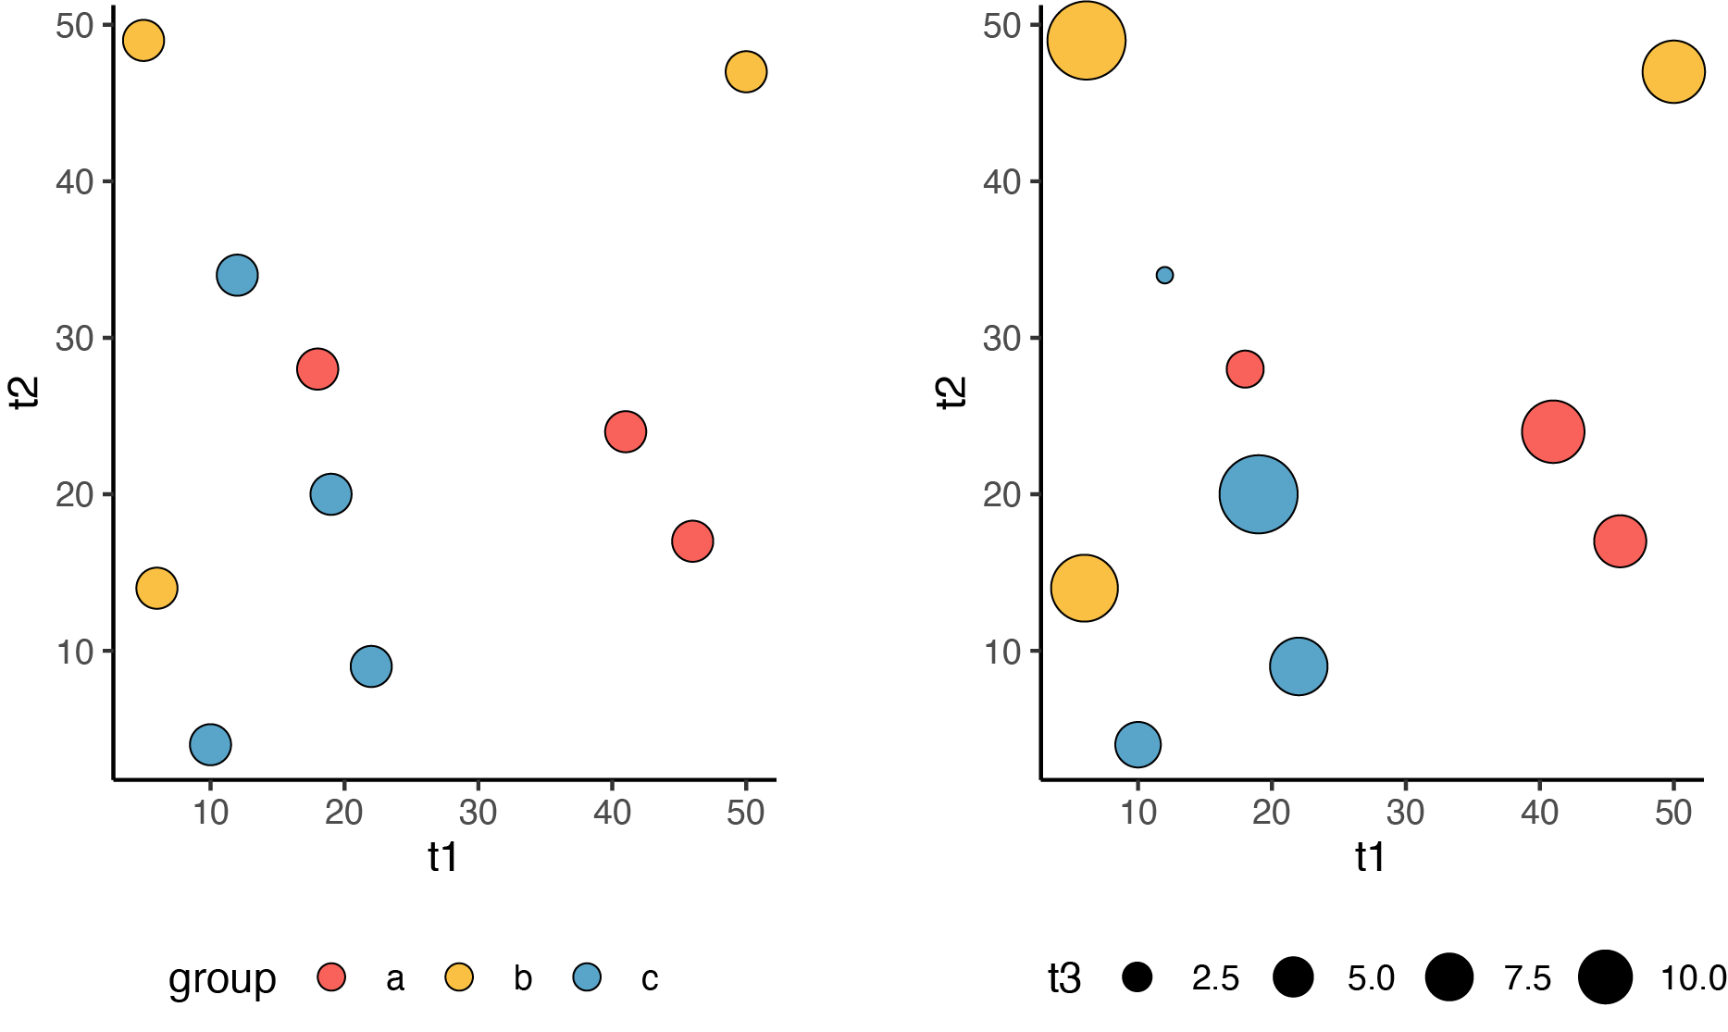

Slide 34
TEXT AND FONTS
SERIF VS. NON-SERIF
•
PLAYFUL VS. CONSERVATIVE
•
TEXT TO MAKE A POINT

Slide 35
GUIDANCE ON HOW TO:
MAKE EVERYONE FALL ASLEEP AND HATE YOUR TALK AND AVOID YOU AT THE COFFEE BREAK AND DAYDREAM ABOUT YOU BEING EATEN BY A GIANT MANTIS AND WONDER IF YOU CUT YOUR OWN HAIR AND GENERALLY FEEL LIKE THEY’VE TAKEN ILLICIT DRUGS THAT MAKE TIME SOLELY A CONSTRUCT OF A CRUEL AND VINDICTIVE GOD.

Slide 36
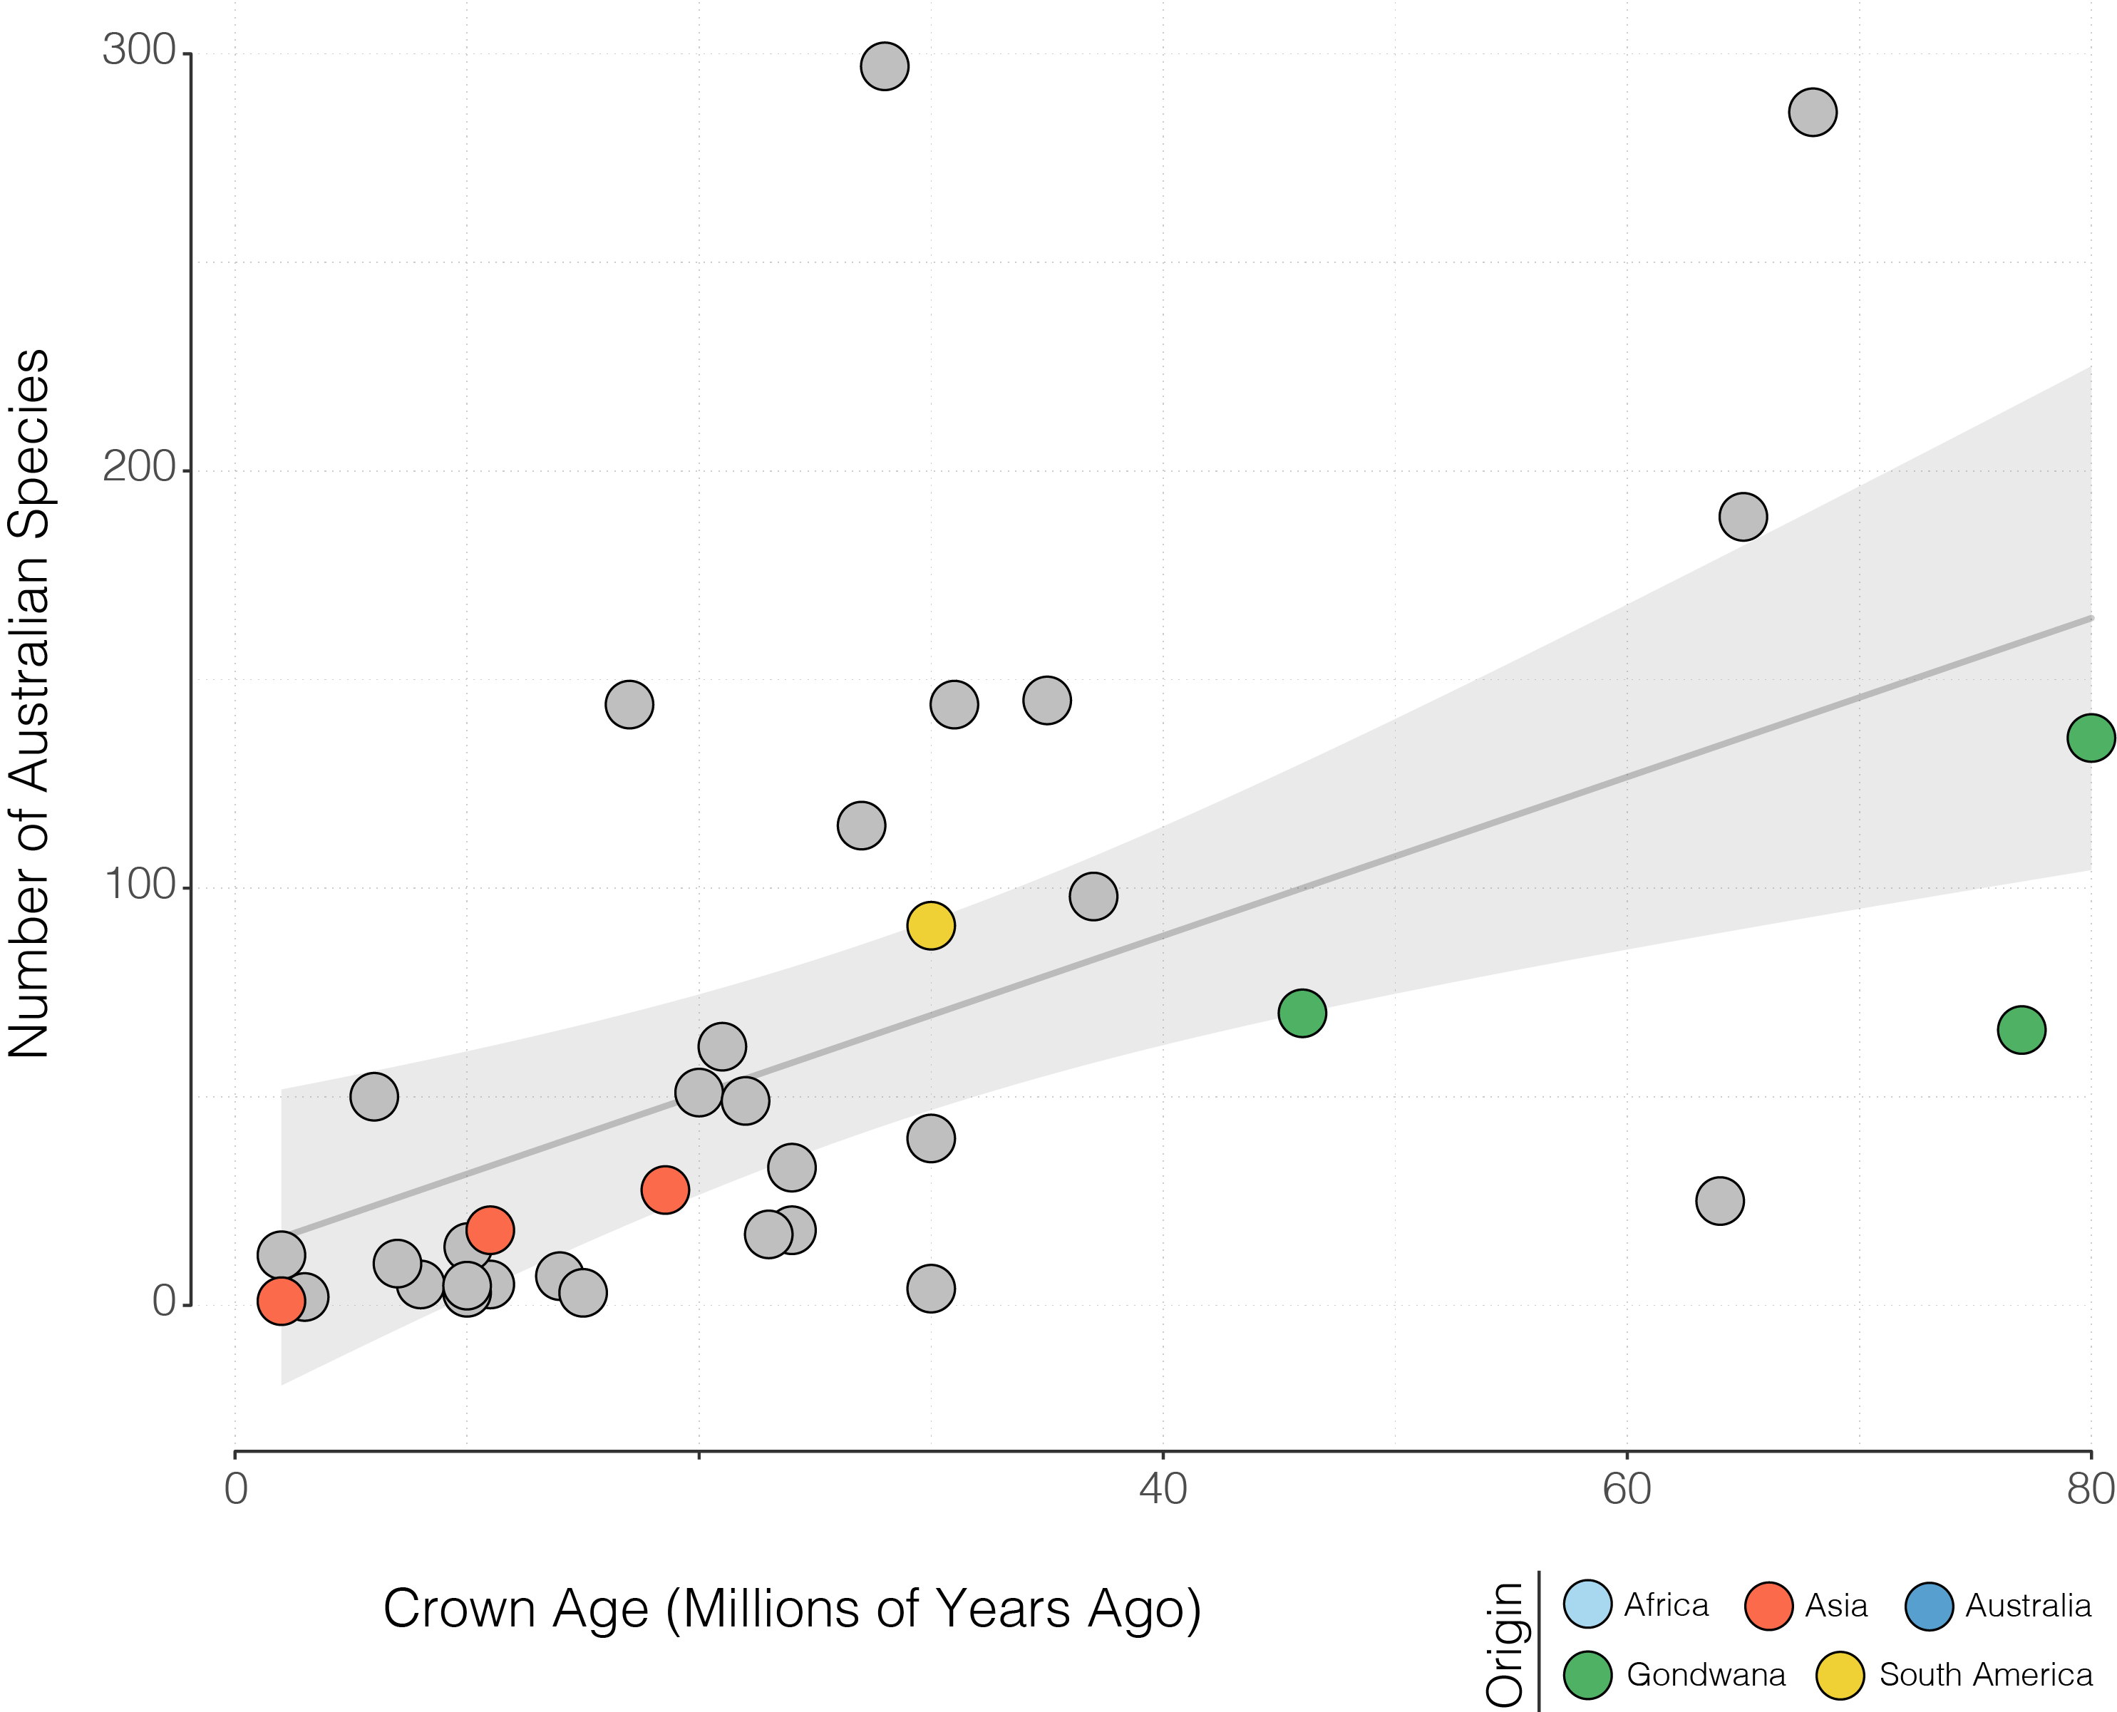

Slide 37
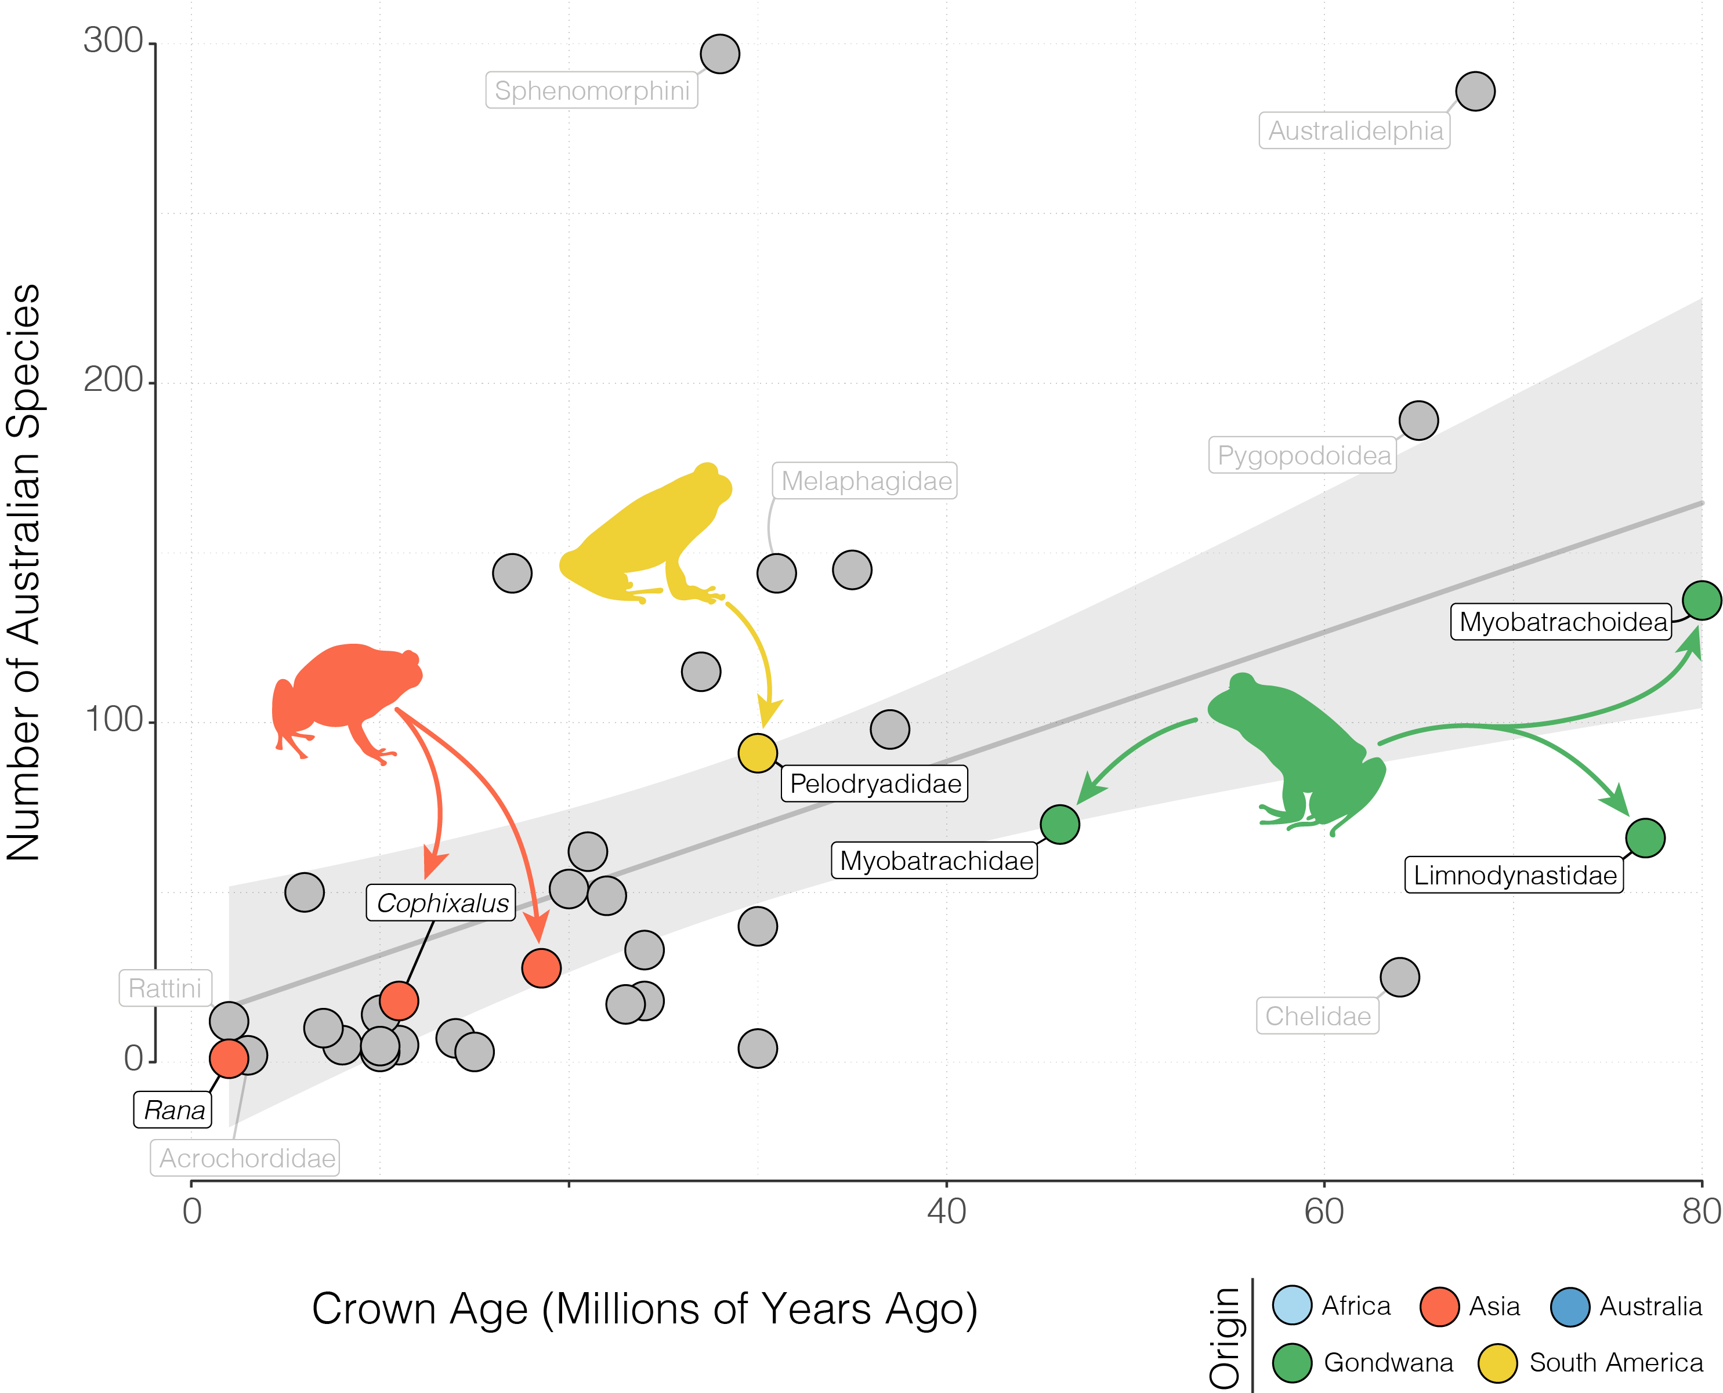

Slide 38
ODDS + ENDS
RULE OF THIRDS
•
DROP SHADOW
•
…
•
…

Slide 39
PAPER
FIGURES
TALK
FIGURES
# SPECIES
POSTER
FIGURES
HABITAT TYPE

Slide 42


Slide 45
USE DROP SHADOW

Slide 46
USE DROP SHADOW
USE DROP SHADOW

